Slide 1
Hackathon 2024
Presenter: 1891_Saumya (Saumya Shah)

Slide 2
Index
Introduction
Module 1
Accuracy
Reliability
Efficiency
Security
Module 2
Continuous market scanning
Dynamic data integration
Real-time property analysis and scoring
Future directions

Slide 3

1. Introduction
Collaborative approach!
Perspective on the problem statement
Tech-stack employed

Slide 4

1. Introduction
Collaborative approach!
Perspective on the problem statement
Tech-stack employed

Slide 5










1. Introduction
Collaborative approach!
Perspective on the problem statement
Tech-stack employed

Slide 6






2. Module 1
Data Collection, Integration, and Management Module Overview

Slide 7
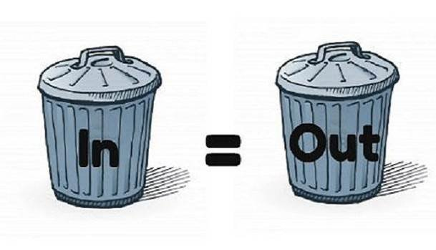
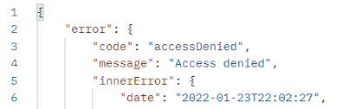

2.1 Accuracy

Slide 8
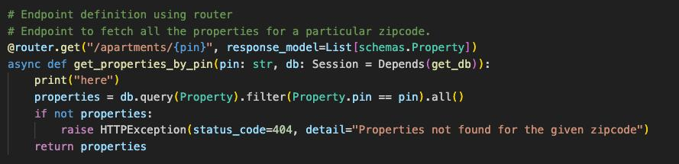
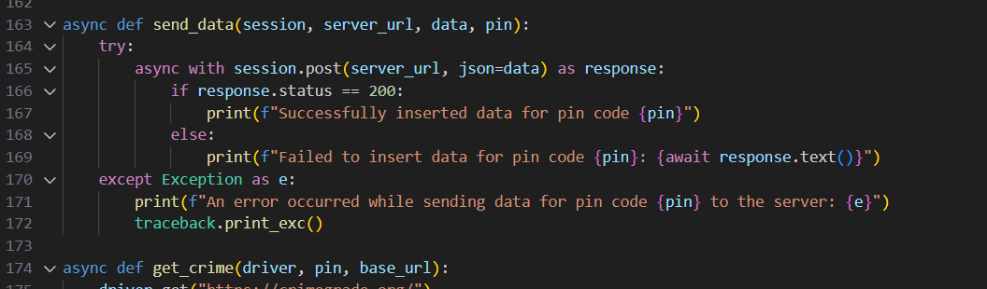
2.2 Reliability
Retry mechanisms
Best coding practices
Exception handling mechanism

Slide 9
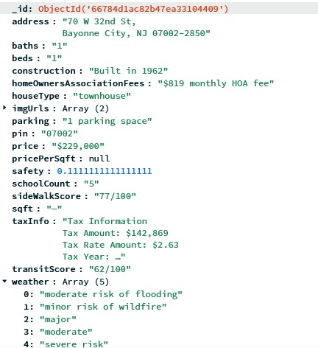
2.3 Efficiency
Asynchronous processing
Time complexity measures
Hashing
Modular programming
DB design (3NF)

Slide 10
2.4 Security
System Design
staging data
FACTS data
Redfin, Marcusmillichap,
Realtor, Zillow, Homes
Selenium bot
MongoDB staging database
Analytics script
AWS RDS MySQL
Data abstraction layer
Enables real-time
Docker
Flask Backend
React Frontend
Instance
Reports

Slide 11
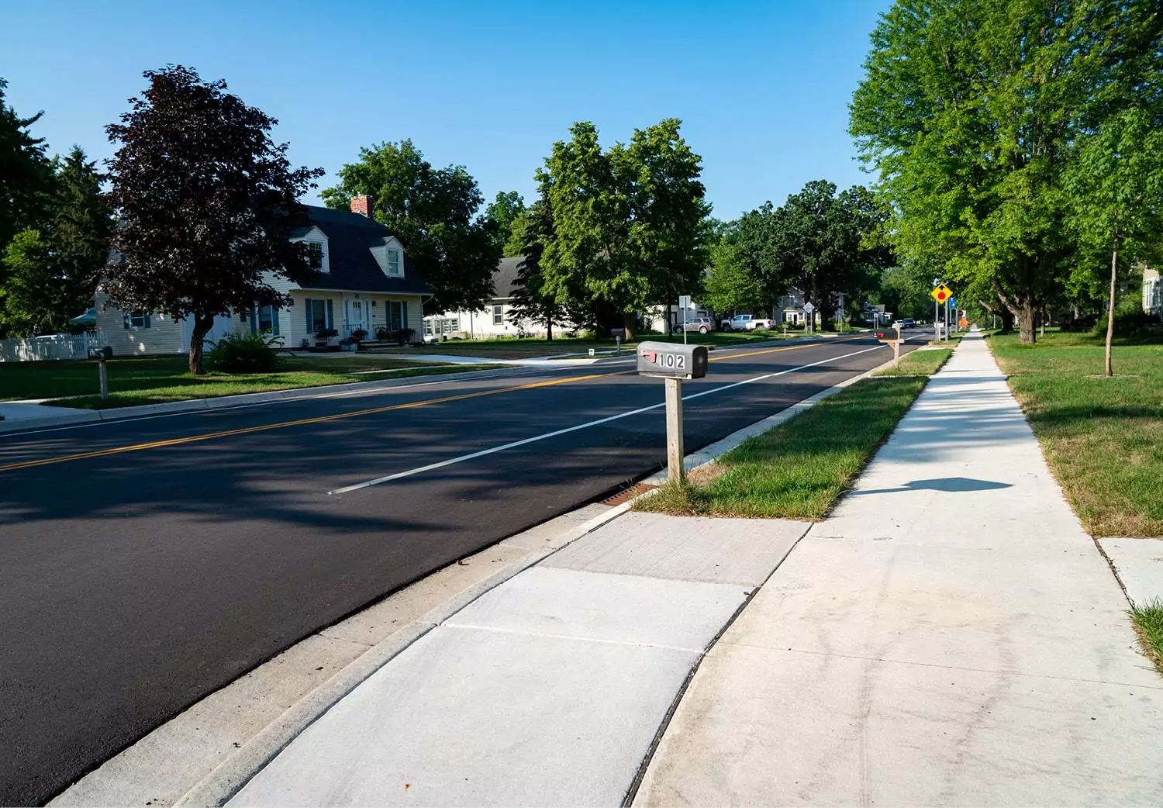
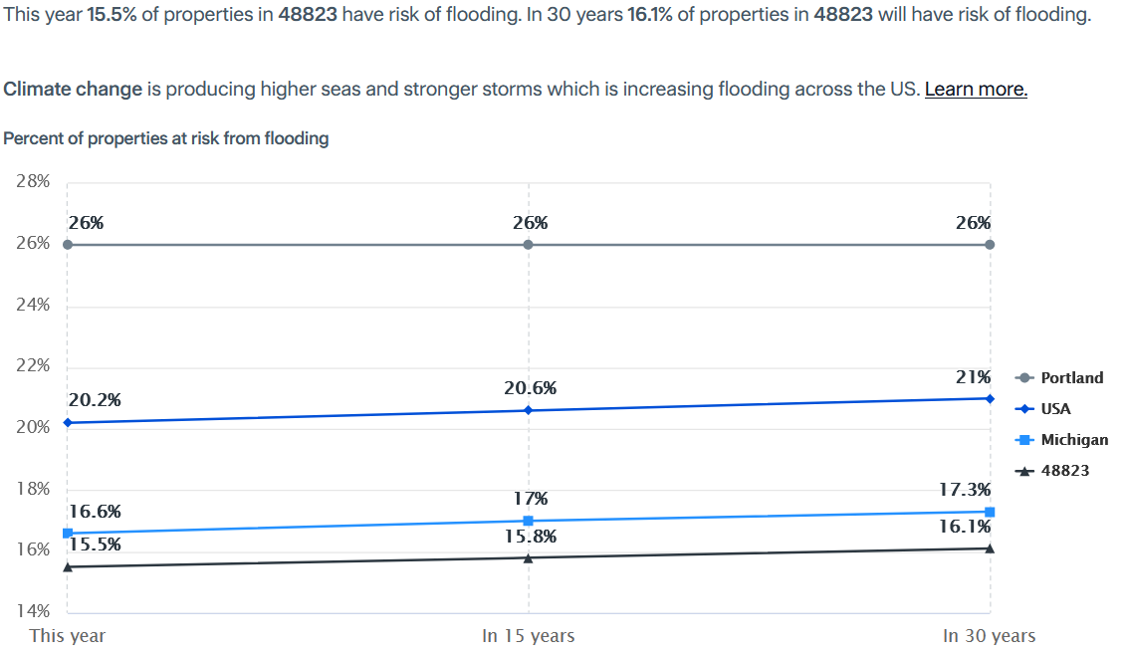

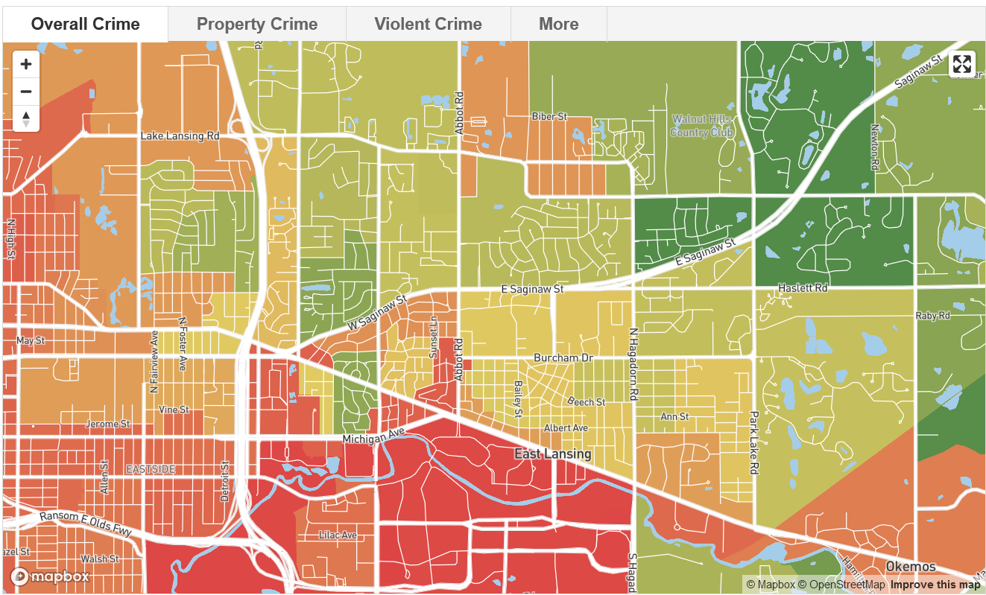

3. Module 2
Market Analysis

Slide 12
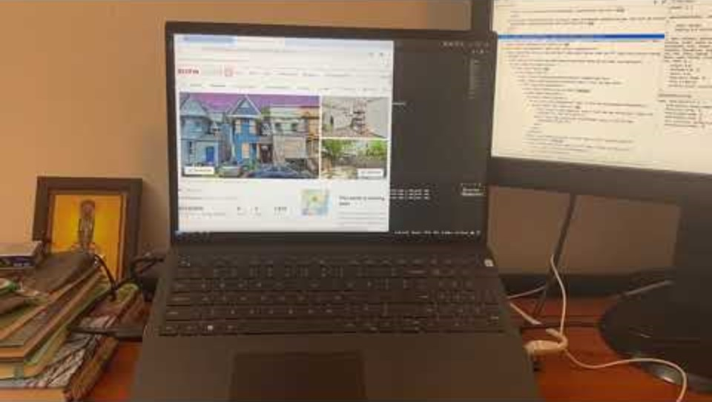
3.1 Continuous market scanning

Slide 13
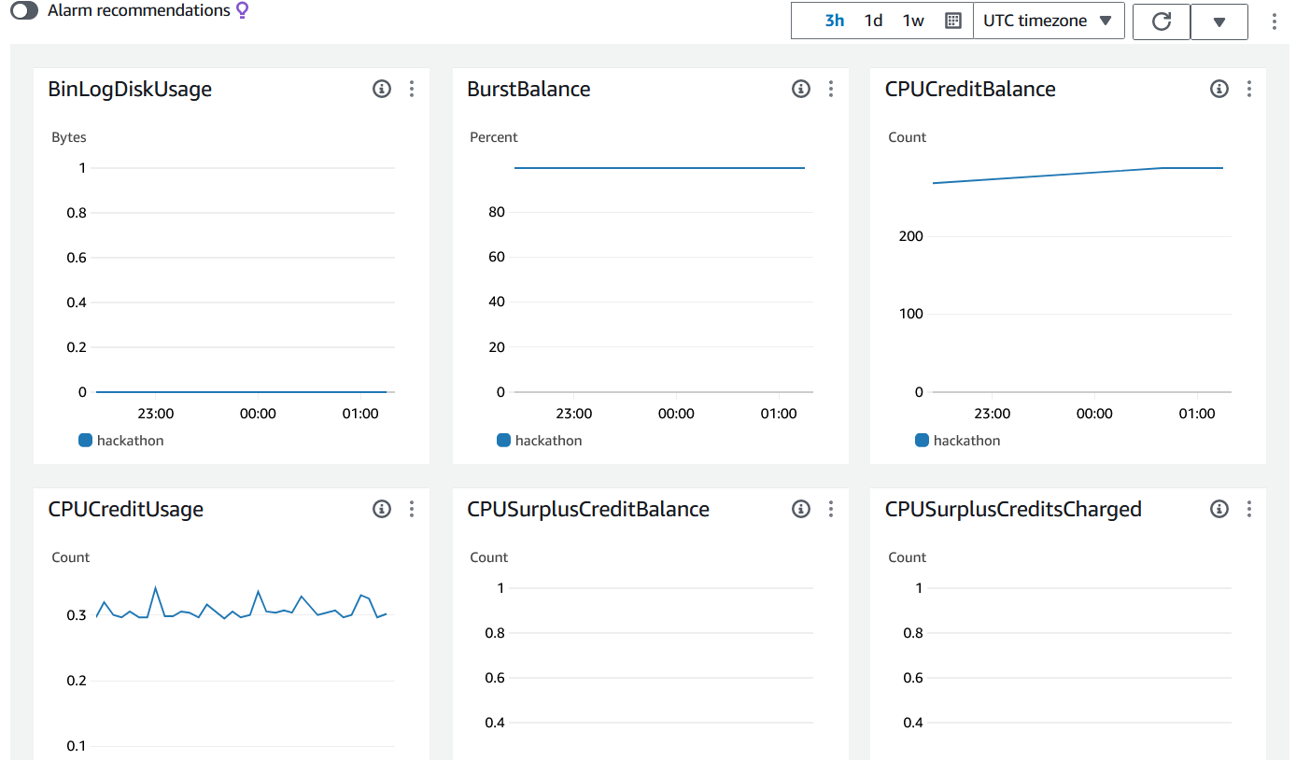
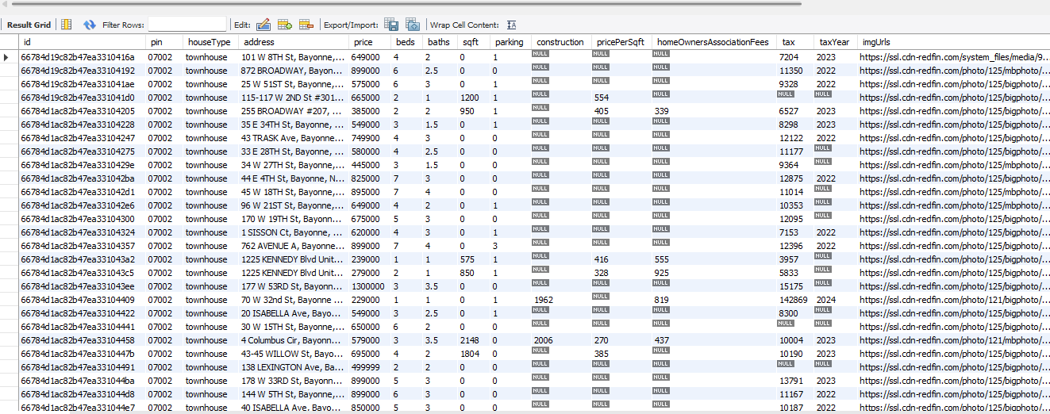
3.2 Dynamic data integration

Slide 14
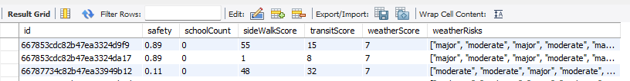
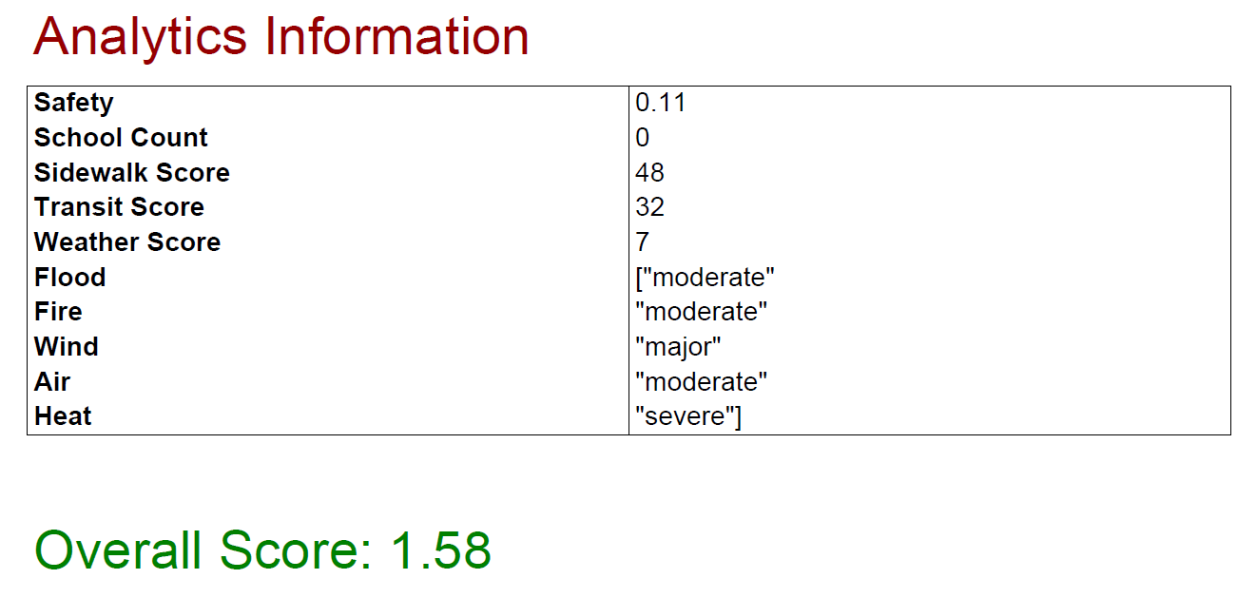
3.3 Real time property scoring

Slide 15
4. Future directions
Financial underwriting
Personalized real estate AI recommendation system
Loan / Mortgage assistance

Slide 16
Thank you

